Slide 1
Genetics
And
Heredity

Slide 2
11.1 The Work of Gregor Mendel Key Questions
Where does an organism get its unique characteristics?
How are different forms of a gene distributed to offspring?
Vocabulary
Genetics Allele
Fertilization Principle of dominance
Trait Segregation
Hybrid gamete
Gene
Page 308

Slide 3
11.1 The Work of Gregor Mendel The Experiments of Gregor Mendel
Where does an organism get its unique characteristics?
An individual’s characteristics are determined by factors that are passed from one parental generation to the next.
Every living thing – plant or animal, microbe or human being – has a set of characteristics inherited from its PARENT (OR PARENTS)

Slide 4
11.1 The Work of Gregor Mendel
The delivery of characteristics from parent
to offspring is called heredity.
The scientific study of heredity is known
as genetics.

Slide 5
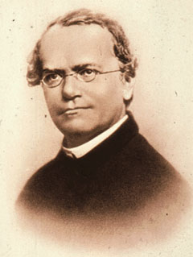
11.1 The Work of Gregor Mendel Gregor Mendel
Born in 1822 in what is now the Czech Republic
Became a priest, studied science and math at the University of Vienna
Next spent 14 years at a monastery teaching high school
He also took care of the monastery gardens
He did his experiments in that garden
Mendel carried out his work with ordinary garden peas partly because:
peas are small
peas are easy to grow and a single pea plant can produce hundreds of offspring.
Peas are called a “model system” because they are convenient to study and may tell how other organisms , including humans, actually function.
Notes:
Austrian Monk, born 1822 in the Czech Republic. Studied science and mathematics at Univ. of Vienna. Spent 14 years working in the monastery and teaching at the high school. He was also in charge of the garden. His work in the garden would change biology forever.

Slide 6
11.1 The Work of Gregor Mendel The Role of Fertilization
During sexual reproduction, male and female reproductive cells join in a process known as fertilization to produce a new cell.
Notes:
When Mendel began his experiments, he knew that the male part of each flower makes pollen, which contains the plant’s male reproductive cells, called sperm. The female portion of each flower produces reproductive cells called eggs.

Slide 7
11.1 The Work of Gregor Mendel
Mendel’s garden had several stocks of pea plants. These plants were “True Breeding”
(self-pollinating, produce identical offspring)
In other words, the traits (specific characteristics) of each generation would be the same.

Slide 8
11.1 The Work of Gregor Mendel
To learn how these traits were determined, Mendel decided to “cross” his stock of true-breeding plants – he caused one plant to reproduce with another plant.
He had to prevent self-pollination, so he cut away the pollen-bearing male parts of a flower. Then he dusted the pollen from a different plant onto the female part of that flower.
This process, known as “cross-pollination”,
allowed Mendel to breed plants with traits different from those of their parents.

Slide 9
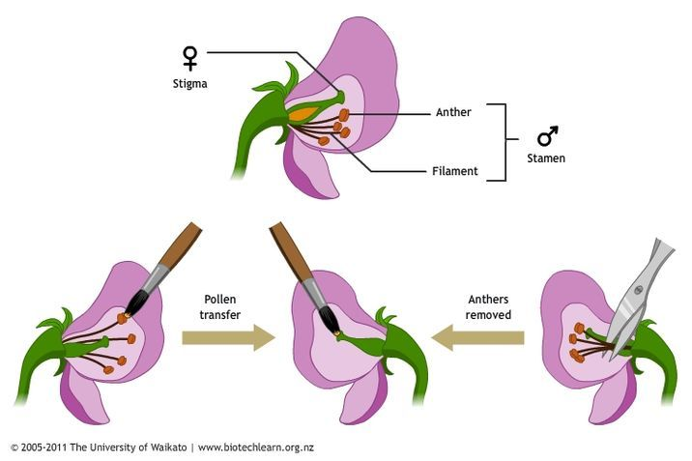
11.1 The Work of Gregor Mendel Cross Pollination
2
1

Slide 10
11.1 The Work of Gregor Mendel
Mendel studied and crossed 7 different pea plant traits. Remember, a trait is a specific characteristic (plant height, seed color…) that varies from on individual to another.
Original pair of plants – P (parental generation)
First generation offspring (first filial) F₁
Second generation offspring (second filial) F₂

Slide 11
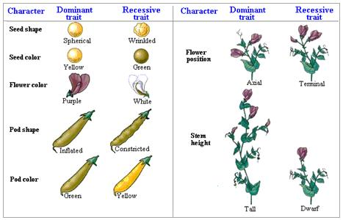
11.1 The Work of Gregor Mendel Mendel’s 7 F₁ Crosses on Pea Plants

Slide 12
11.1 The Work of Gregor Mendel Some Latin…
Filius and filia are Latin words for “son” and “daughter” respectively.
The offspring of crosses between parents with different traits are called hybrids.
An individual’s characteristics are determined by factors that are passed from one parental generation to the next.
Scientists call the chemical factors that determine traits genes.
The different forms of a gene are called alleles. The gene for pea shape, for example, has two alleles – one for round peas and another for wrinkled peas.

Slide 13
11.1 The Work of Gregor Mendel
What were those F₁ hybrid plants like? Did the characters of the parent plants blend in the offspring?
To Mendel’s surprise – NO! All of the offspring had the character of only one of the parents. In each cross, the character of the other parent seemed to disappear.
Mendel drew two conclusions…
Biological inheritance is determined by factors that are passed from one generation to the next generation.
The Principle of Dominance stated that some alleles are dominant and others are recessive

Slide 14
11.1 The Work of Gregor Mendel
Your cells, like the pea plant’s cells, have two alleles for each gene – one for each chromosome of a homologous pair. The term homozygous (HOH-moh-ZY-guhs) means the two alleles of a gene are the same (for example, both alleles are for round peas)
RR or rr
The term heterozygous (HEHT-uhr-uh-ZY-guhs) means the two alleles are different – for example, one allele is for wrinkled peas and one is for round peas)
Rr
For Mendel’s peas, if a plant was heterozygous for pea shape, the pea shape would be round. This is because the allele for round peas is dominant or expressed when two different alleles are present.

Slide 15
11.1 The Work of Gregor Mendel
Mendel studied traits that had just 2 alleles, one dominant and one recessive. The allele for tall plants was dominant and the allele for short plants was recessive. However, most traits involve much more complicated patterns of inheritance.
DOMINANT ALLELES – CAPITAL LETTERS
recessive alleles – lower case letters
A recessive allele is expressed only when there are two copies of the recessive allele.
A dominant allele is not better or stronger or more common; it is simply the allele that is expressed when there are 2 different alleles.

Slide 16
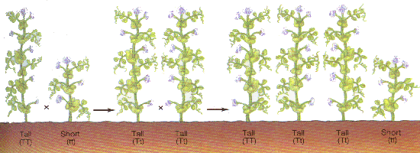
Mendel’s Pea Plants
P
F1
F2
Notes:
P generation – F1 generation – F2 generation

Slide 17
11.1 The Work of Gregor Mendel Segregation
How are different forms of a gene distributed to an offspring?
During gamete formation (the sex cells), the alleles for each gene segregate from each other, so that each gamete carries only one allele for each gene.
Mendel’s work didn’t just stop with crossing parent plants. Where did the recessive alleles go? Did they just disappear, or were they still present in the new plants?
Mendel allowed all 7 kinds of F₁ hybrids to self-pollinate. (He crossed the F₁ generation with itself.)
Remember that the offspring of the F₁ cross are called F₂ (second filial) generation.

Slide 18
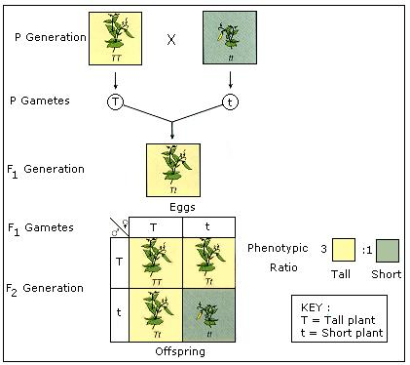
11.1 The Work of Gregor Mendel Results of F₁ Cross

Slide 19
11.1 The Work of Gregor Mendel Mendel figured out that…
When each F₁ plant flowers and produces gametes, the two alleles segregate (separate) so that each gamete carries only a single copy of each gene. Therefore, each F₁ plant produces two types of gametes – those with the allele for tallness and those with the allele for shortness.
Whenever a gamete that carried the t allele paired with the other gamete that carried the t allele they produced an F₂ plant that was short.
Every time one or both gametes of the pairing carried the T allele, the plant was tall.
The F₂ generation had new combinations of allelles.

Slide 20
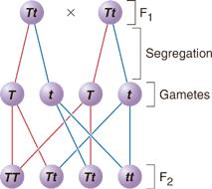
11.1 The Work of Gregor Mendel Segregation of Alleles

Slide 21
11.2 Applying Mendel’s Principles
Pages 313 - 318
Key Questions
How can we use probability to predict traits?
How do alleles segregate when more than one gene is involved?
What did Mendel contribute to our understanding of genetics?
Vocabulary
Probability Phenotype
Punnett square Genotype
Homozygous Independent
Heterozygous assortment
Page 313

Slide 22
11.2 Applying Mendel’s Principles Probability and Punnett Squares
Probability – the likelihood that a particular event will occur
Example: Flipping a coin – heads or tails. The probability that a single coin flip will come up heads is 1 chance in 2. This is 1/2, or 50%.
If you flip the coin 3 times in a row, what is the probability that it will land heads up every time?
½ X ½ X ½ = 1/8
You have 1 chance in 8 of flipping heads three times in a row.

Slide 23
11.2 Applying Mendel’s Principles Probability and Punnett Squares
The principles of probability can be used to
predict the outcomes of genetic crosses.
The gene combinations that MIGHT result from a genetic cross can be determined by drawing a diagram called a Punnett square.
Punnett squares use mathematical probability to help predict the genotype and phenotype combinations in genetic crosses.
Organisms that have 2 identical alleles for a particular trait – TT or tt are said to be homozygous. (true-breeding)
Organisms that have 2 different alleles for the same trait are heterozygous (hybrid) Tt

Slide 24
11.2 Applying Mendel’s Principles Probability and Punnett Squares
How can we use
probability to predict
traits?
Punnett squares use mathematical probability to help predict the genotype and phenotype combinations in genetic crosses.

Slide 25
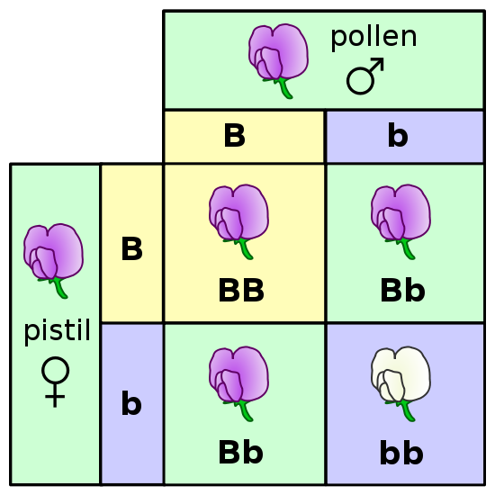
11.2 Applying Mendel’s Principles Probability and Punnett Squares Punnett Square for Flower Color One Factor Cross Ratio 3:1
One Factor Cross
Bb and Bb

Slide 26
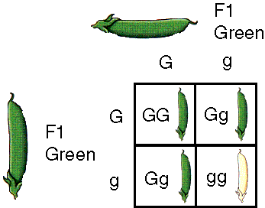
11.2 Applying Mendel’s Principles Probability and Punnett Squares One Factor Cross
One Factor
Cross
Gg and Gg

Slide 27
11.2 Applying Mendel’s Principles Independent Assortment
How do alleles segregate when more than one gene is involved?
The principle of independent assortment states that genes for different traits can segregate independently during the formation of gametes.

Slide 28
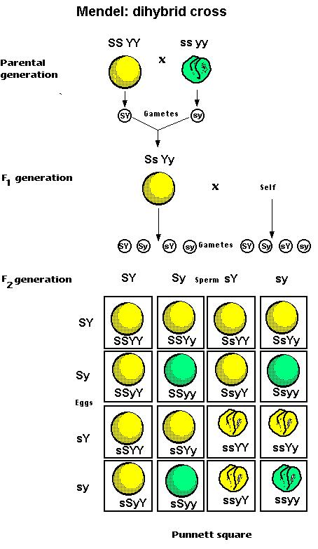
Two-factor Cross (Ratio 9:3:3:1)
S=smooth
s=wrinkled
Y=yellow
y=green

Slide 29
Two-factor Cross Pea Pod Color and Pea Color
Pea Pod Color
Pea Color
G=green g=yellow Y=yellow y=green

Slide 30
11.2 Applying Mendel’s Principles A Summary of Mendel’s Principles These Principles are…
The inheritance of biological characteristics is determined by individual units called genes, which are passed from parents to offspring.
When 2 or more forms (alleles) of the gene for a single trait exist, some alleles are dominant and some are recessive.
In most sexually reproducing organisms, each adult has 2 copies of each gene – one from each parent. These genes segregate (separate) from each other when gametes are formed.
Alleles for different genes usually segregate independently of each other

Slide 31
11.2 Applying Mendel’s Principles A Summary of Mendel’s Principles
Mendel’s experiments didn’t apply to just plants. In the early 1900’s and American geneticist, Thomas Hunt Morgan used fruit flies (Drosophila melanogaster)
Fruit flies are small, can produce lots of offspring – a single pair can produce hundreds of young, and they are easy to keep in a lab

Slide 32
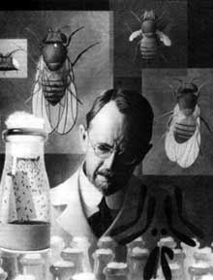
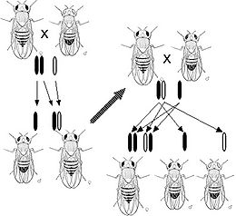
11.2 Applying Mendel’s Principles Summary of Mendel’s Principles
Thomas Hunt Morgan

Slide 33
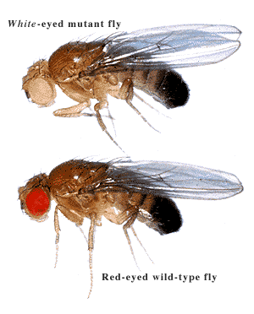
11.2 Applying Mendel’s Principles Summary of Mendel’s Principles
Before long, Morgan and other biologists had tested Mendel’s principles and learned that they applied to flies and other organisms as well. In fact, Mendel’s basic principles can be used to study inheritance of human traits and to calculate the probability of certain traits appearing in the next generation.
Drosophila melanogaster (Fruit fly)

Slide 34
11.3 Other Patterns of Inheritance
Pages 319 – 321
Key Questions
What are some exceptions to Mendel’s principles?
Does the environment have a role in how genes determine traits?
Vocabulary
Incomplete dominance Multiple allele
Co-dominance Polygenic trait
Page 319

Slide 35
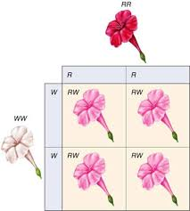
11.3 Other Patterns of Inheritance Incomplete Dominance
What are some exceptions to Mendel’s
principles?
Some alleles are neither dominant nor recessive.
The F1 generation produced by across
between red-flower (RR) & white-flowered (WW)
Plants consists of pink-colored flowers (RW).
Which allele is dominant in this case? Neither one
Cases where one allele is not completely dominant
Over another is called incomplete dominance.
This means the heterozygous phenotype lie
somewhere between the two heterozygous phenotypes

Slide 36
11.3 Other Patterns of Inheritance
Codominance – where phenotypes produced by both alleles are clearly expressed.
Two alleles affect the phenotype in separate and distinguishable ways.
Neither allele can mask the other and both are expressed in the offspring and not in an “intermediate” form.
Example: red flowers that are crossed with white flowers that yield red and white flowers.

Slide 37
11.3 Other Patterns of Inheritance Examples of Codominance
Black chicken and white chicken produce a chicken speckled with black and white feathers called “erminette”.
White and Red flowers produce flowers with both red and white colors together

Slide 38
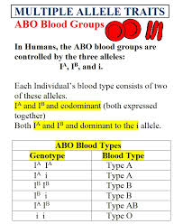
11.3 Other Patterns of Inheritance Multiple Alleles
What are some exceptions to Mendel’s principles?
Many genes exist in several different forms and are therefore said to have multiple alleles
A gene with more than two alleles is said to have multiple alleles.

Slide 39
11.3 Other Patterns of Inheritance Multiple Alleles

Slide 40
11.3 Other Patterns of Inheritance Polygenic Traits
What are some exceptions to Mendel’s principles?
Many traits are produced by the interaction of several genes.
Traits controlled by two or more genes are said to be polygenic traits.
Polygenic traits often show a wide range of phenotypes.
The variety of skin color in humans comes about partly because more than four different genes probably control this trait.

Slide 41
11.3 Other Patterns of Inheritance Polygenic Traits
Qualitative variation usually indicates polygenic inheritance. This occurs when there is an additive effect from two or more genes. Pigmentation in humans is controlled by at least four (4) separately inherited genes.

Slide 42
11.3 Other Patterns of Inheritance Genes and the Environment
What are some exceptions to Mendel’s principles?
Environmental conditions can affect gene expression and influence genetically determined traits.
An individual’s actual phenotype is determined by its environment as well as its genes.
The phenotype of an organism is only partly determined by its genotype.

Slide 43
11.3 Other Patterns of Inheritance Genes and the Environment

Slide 44
11.3 Other Patterns of Inheritance Genes and the Environment
In the western white butterfly, to fly effectively, the body temperature must be 28*C – 40*C (about 84*F - 104*F ). Since spring months are cooler in the west, greater pigmentation helps the butterfly reach the body temperature needed for flight (darker wings) and in the hot summer months they need less pigmentation to prevent overheating (lighter wings).

Slide 45
CHAPTER 14 Human Heredity
14.1 Human Chromosomes
HE.912.C.1.4
Analyze how heredity and family history can
impact personal health

Slide 46
SMALL SAMPLE OF THE VARIATION THAT EXISTS AMONG HUMANS…

Slide 47
14.1 Human Chromosomes
Pages 392 - 395
Key Questions
What is a karyotype?
What patterns of inheritance do human traits follow?
How can pedigrees be used to analyze human inheritance?
Vocabulary
Genome Autosome
Karyotype Sex-linked gene
Sex chromosome Pedigree

Slide 48
14.1 Human Chromosomes Karyotypes
What is a karyotype
A karyotype shows the complete diploid set of chromosomes grouped together in pairs arranged in order of decreasing size.
The genome is the full set of genetic
information that an organism carries in its DNA. The study of any genome starts with chromosomes, the bundles of DNA and protein found in the nuclei of eukaryotic cells.

Slide 49
14.1 Human Chromosomes Karyotypes
Notes:
A typical human cell contains 46 chromosomes, arranged in 23 pairs. Why do our chromosomes come in pairs?

Slide 50
14.1 Human Chromosomes Sex chromosomes
Two of the 46 chromosomes in the human genome are known as sex chromosomes.
Male – XY - 50% of sperm cells carry X chromosomes and 50% of sperm cells carry Y chromosomes
Female – XX - (all human eggs carry a single X chromosome

Slide 51
14.1 Human Chromosomes Sex chromosomes
As you can see, this is the reason why males and females are born in roughly a 50:50 ratio.

Slide 52
14.1 Human Chromosomes Autosomal Chromosomes (Autosomes)
Remaining 44 chromosomes are autosomes.
44 autosomes + 2 sex chromosomes = 46 chromosomes
To summarize the total number of chromosomes present in a human cell – both autosomes and sex chromosomes – biologists write:
46, XX for females
46,XY for males

Slide 53
Patterns of Heredity and Human Genetics
Examples of Inherited
Traits in Humans

Slide 54
Simple Dominant Traits
Cleft Chin
Dimples

Slide 55
Simple Dominant Traits
Widow’s Peak Dominant
Earlobe Type
Free/Detached Earlobes is dominant

Slide 56
Simple Dominant Traits
Hitchhiker’s Thumb Dominant
“Straight” Thumb Recessive

Slide 57
Simple Dominant Traits
Other Simple Dominant Traits in Humans
Almond-shaped eyes vs round eyes
Thick lips vs thin lips
Presence of hair on middle section of fingers
Brown eyes vs grey, green, hazel, blue eyes
Freckles vs non-freckles
Dark Hair vs blonde, light, or red hair
Non-Red Hair vs Red Hair
Normal Hearing and Speaking vs Deaf / Mutism
Normal pigmented skin vs albinism
Normal blood clotting vs Hemophilia

Slide 58
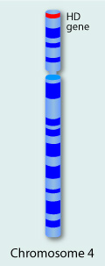
The gene for Huntington’s Disease is
found on Chromosome 4.

Slide 59
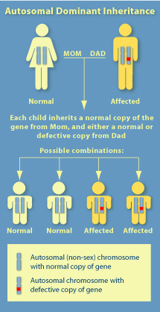

Slide 60
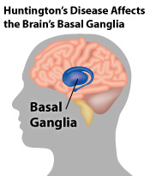
A neurodegenerative genetic disorder
Leads to cognitive decline & dementia
Physical symptoms usually begin
between 35 and 44 years of age
Symptoms begin with gradual lack of
coordination until body movement
becomes jerky and uncoordinated
Mental abilities generally decline
into dementia (loss of memory,
thinking, speech, etc.)
Life expectancy is around twenty years
after the onset of symptoms
There is no cure for HD
Full-time care is required in the latter
stages of the disease

Slide 61
Genetic Pedigree Chart Huntington’s Disease

